Slide 1

Assignment of Project
Microsoft Clarity
Assignment: In this assignment, we'll be exploring how to leverage Microsoft Clarity, a powerful analytics tool, to analyze user interactions with our application. Specifically, we'll focus on determining which features are most frequently used by our users.

Slide 2
Introduction
Setup and configuration
Identifying Key Features of Application’s interface
Data Analysis
Contents
Some of the Terms in Microsoft clarity
Insights on the most frequently used features
User Engagement Pattern
Recommendation for optimizing feature usage.

Slide 3

Promact
Introduction to
Microsoft Clarity
It is a powerful analytics tool that provides insights into user behavior on websites or applications. It offers features like heatmaps, session recordings, and click tracking to help businesses understand how users interact with their digital platforms.

Slide 4
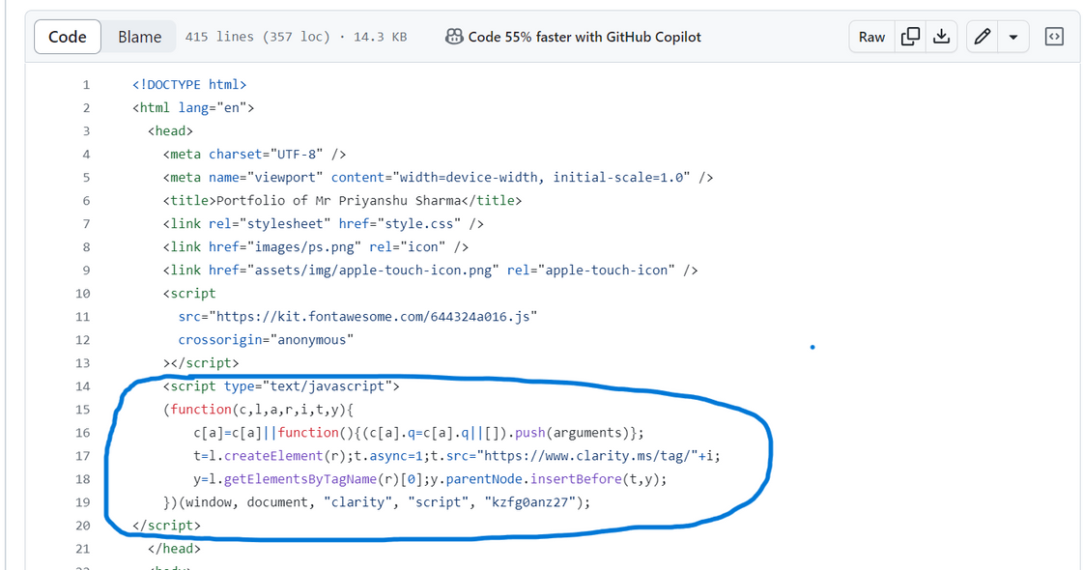
Setup and Configuration
Sign Up and Create Account:
Install Clarity Code:
Customize Tracking Settings:
Verify Installation and Testing:
Visit the Microsoft Clarity website and sign up for an account using our credentials. Once signed up, create a new project for the website or application we want to track.
In the Clarity dashboard, find your project's unique tracking code as script.. Copy this code and paste it into the HTML of every page we want to track, just before the closing </head> tag.
we can enable features like heatmaps, session recordings, and click tracking, and adjust settings such as session duration and data retention periods.
After installing the Clarity tracking code, Navigate through different pages and interact with elements to ensure that Clarity is capturing user data accurately.

Slide 5
Identifying Key Features of Application’s interface
Buttons: Clarity can track clicks on buttons, actions like "Submit," "Save," "Download," “Search,” “Text”, etc.
Links: Clicks on hyperlinks, navigation menus, or any other clickable elements can be tracked to understand user navigation patterns.
Forms: Interaction with form elements such as text fields, dropdowns, checkboxes, and radio buttons can be monitored to analyze user input and form submission behavior.
Menus and Navigation: Clarity can detect clicks on menu items, navigation bars, tabs, and dropdown menus to understand how users navigate through your website or application.
Sections and Content Blocks: Tracking user scrolls and clicks within specific sections or content blocks can provide insights into which parts of your website or application users find most interesting or relevant.
External Links and Downloads: Clicks on external links leading to other websites or downloads initiated from the website can be tracked to understand user behavior beyond our site.
Back to Agenda Page

Slide 6
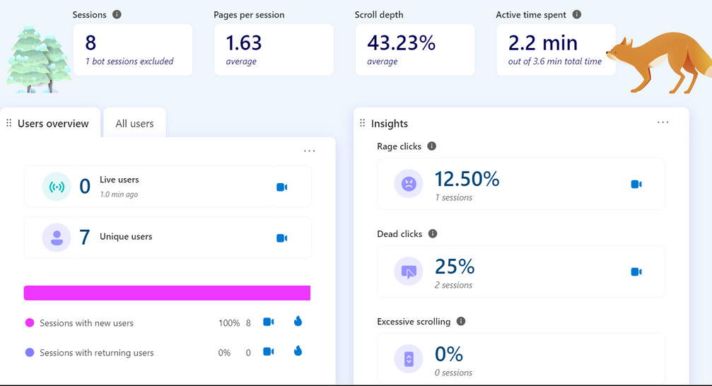
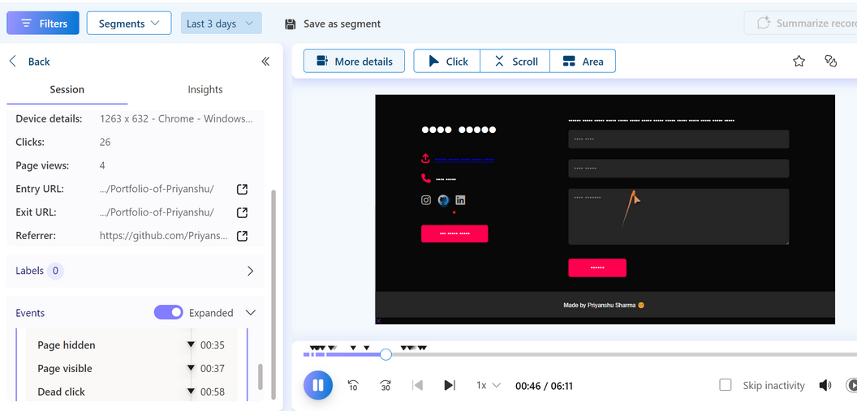
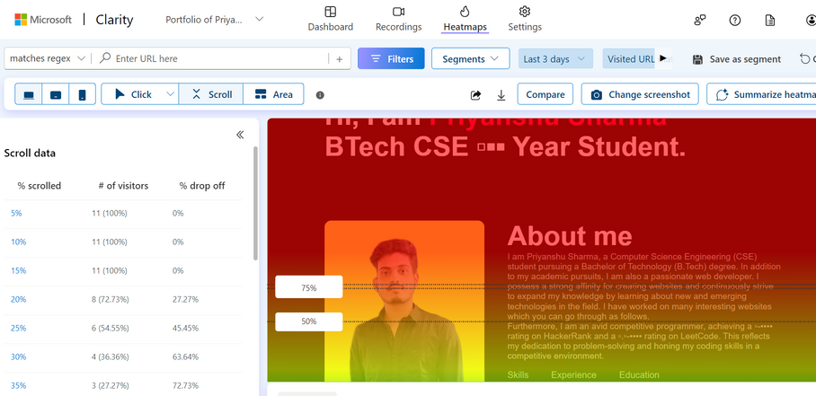
Data Analysis:
In data analysis by Microsoft Clarity, the dashboard, heatmaps, and recordings play vital roles in providing insights into user interactions with the website or application. Here's how each of these elements contributes to efficiently identifying which buttons and features are clicked and accessed frequently:
Dashboard: It shows various datas like Active time spent, scroll depth, users overview which shows how many unique users and live users are their, Insights shows how much percent of the webpage contains dead clicks, rage clicks, excessive scrolling, and quick backs, then browsers section to show in which all browser that website is been accessed.
Recording: we can access the recordings of the user’s behaviour in our hosted website. in which we can track the clicks, scroll, time spent in particular sections.
Heatmaps: In heatmaps we can get the heat zones, like in which area and features their is maximum of users accessing them, clicking or scrolling.

Slide 7
Some of the Terms in Microsoft clarity
Rage Clicks: It refers to instances when a user repeatedly clicks on an element or area of a webpage in frustration or annoyance. These clicks typically occur when the user encounters an unresponsive or malfunctioning element, or a broken link in such as a button that doesn't work or a link that doesn't lead to the expected destination.
Dead Clicks: These are clicks made by users on elements of a webpage that are not interactive or do not have any intended functionality. These clicks typically occur when users mistakenly believe an element, such as an image or non-clickable text, to be interactive or when they expect certain functionality from an element that does not provide it.
Quick Backs: It refers to a quick navigation option allowing users to return to a previous page or section of a website rapidly, it usually occurs either the users sees any data which is not relevant to them or which is repeated several times,
Excessive Scrolling: It refers to a user behavior where individuals scroll through a webpage extensively, often beyond the typical or expected amount. For it their can be any reason like lack of interest, confusion, over repeated datas which might not be required.
It's crucial to recognize that any occurrence of excessive scrolling, rage clicks, or dead clicks on a website can indicate potential areas for improvement in the user experience. Addressing these issues is vital to enhancing the overall satisfaction of visitors. and this process only is discussed in further slides by analyzing data by clarity.

Slide 8
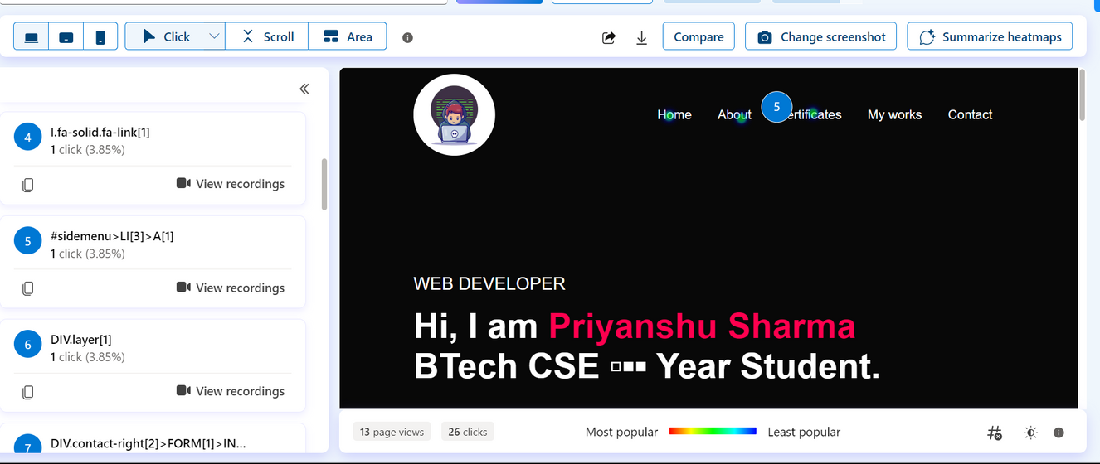
Insights on the most frequently used features
To track and note the data of most frequently used features we need to take reference from the data report provided by the microsoft clarity either in dashboard , heatmap, or in recordings.
Suppose lets assume our own demo website in which we have put microsoft clarity’s script to record and analyse data from which we will try to know the most frequently used features, buttons by the users
Back to Agenda Page
Using Heatmaps for data collection to know in which features and buttons are most frequently clicked by the user
Since this is Demo data so we are handling with very less amount of data analysis, so here we can notice that their are some clicks on the nav bar section.

Slide 9
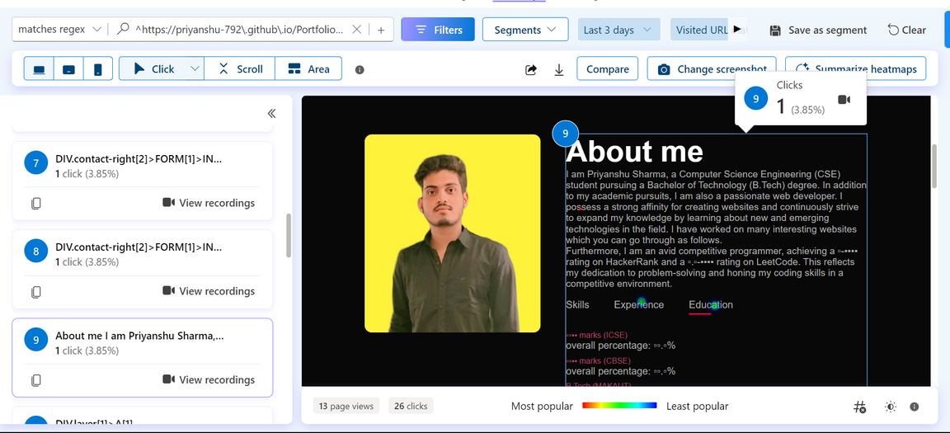
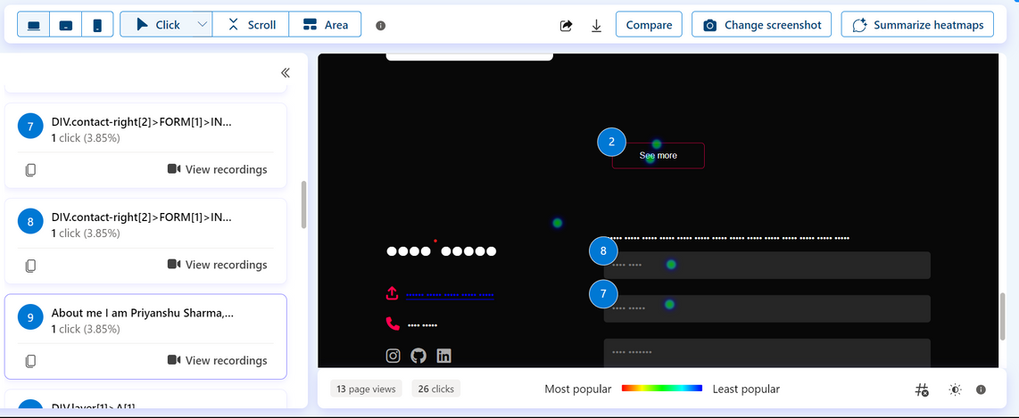
Here we can see some clicks on the Experience, and Education Feature.
Here we can see some clicks on the forms section, see more button , on submit button.
Above all are the clicks which shows the features which is most frequently used by the users.
Users on desktop devices scrolled down the page until the end, but only 23.1% of them reached the 100% scroll depth.
Users on desktop devices clicked mostly on the
Made by Priyanshu Sharma 😊
text at the bottom of the page, which is a dead click.
Users on desktop devices also clicked on the Real estate website project, the Certificates section, the About section, and the Portfolio title (which are also dead clicks).

Slide 10
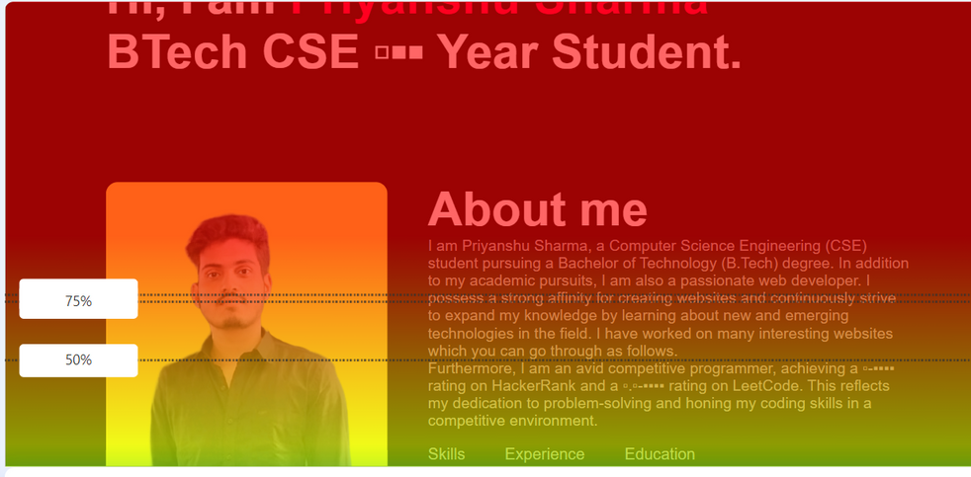
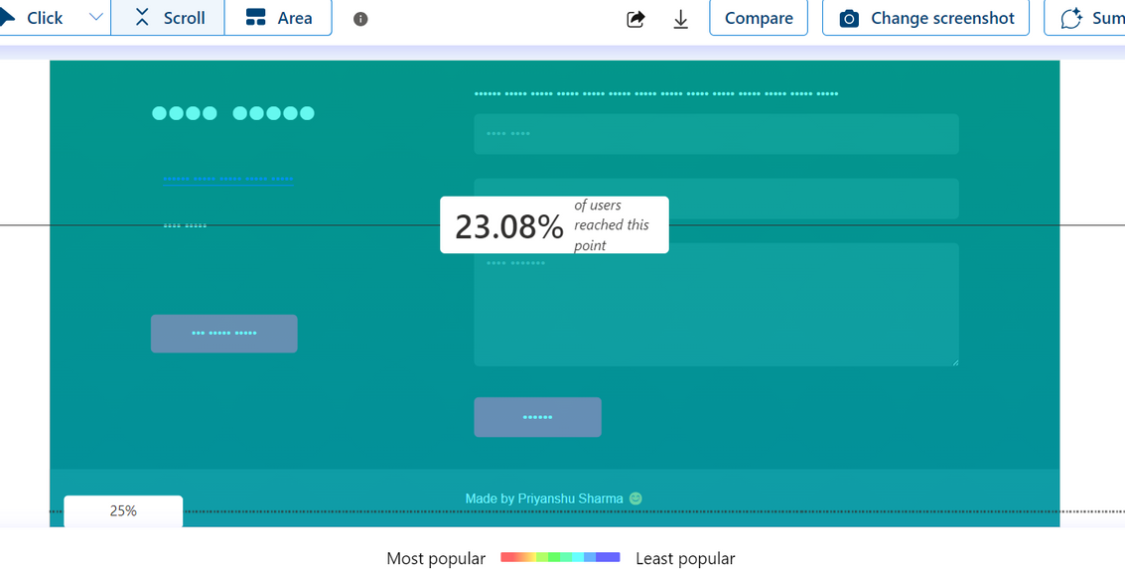
User Engagement Patterns
The difference in the above and the bottom shows the user engagement by how much the users entered the website and out of which how much users had gone through the website completely till bottom by scrolling.

Slide 11
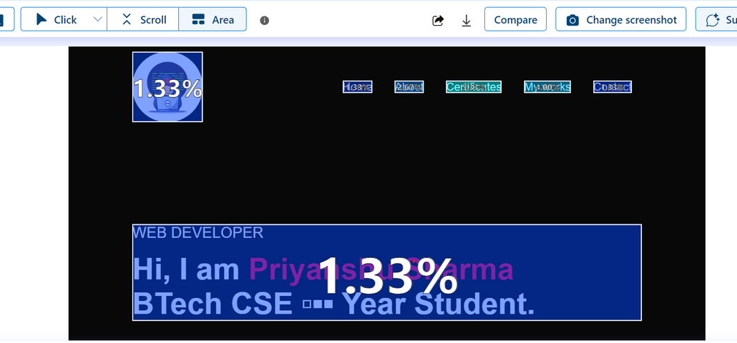
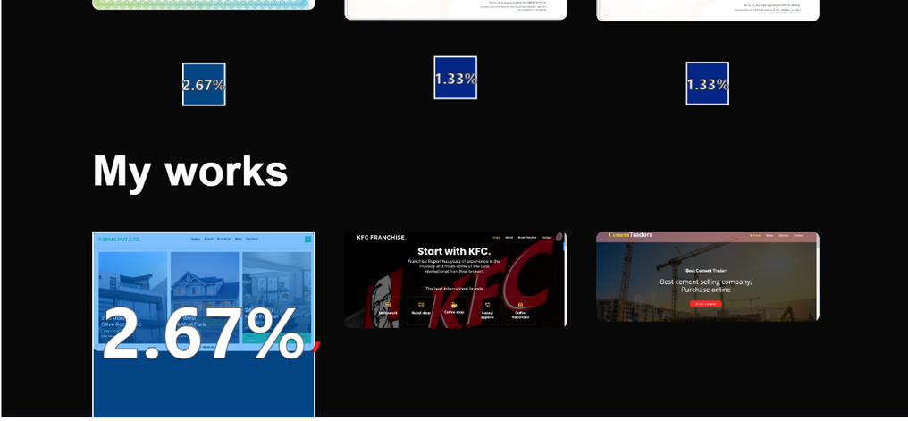
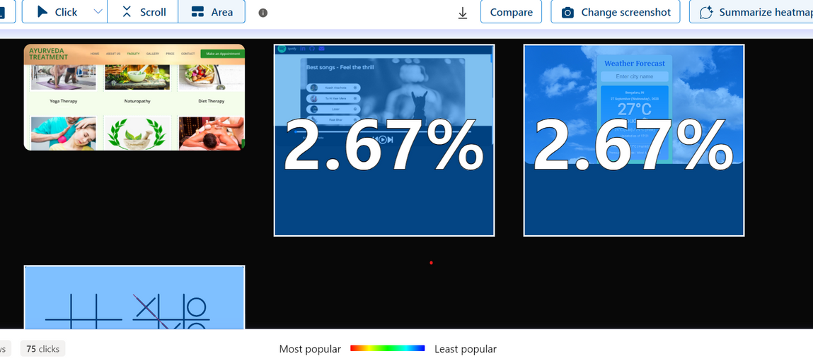
All these percentage shows the user engagements in the entire websites either by their interest or through their clicks.

Slide 12
Recommendations for optimizing feature usage.
we can showcase the portfolio and encourage contact, the website could use a more prominent and engaging call to action at the bottom of the page, or move the contact form to a higher position.
To optimize the user experience and navigation, the website could avoid using non-clickable elements that look like buttons or links, such as the Made by Priyanshu Sharma 😊 or by giving some information to it after clicking so that users can see it, text and the banner text.
To improve the page design and layout, the website could use more whitespace, contrast, and hierarchy to highlight the most important information and elements, such as the portfolio projects and the contact details.
We need to optimize the website in such way that their is the minimum percentage of rage clicks, dead clicks, excessive scrolling, and Quick backs.

Slide 13
Necessary changes that can be done in websites after data analysis for microsoft clarity:
After analyzing data from Microsoft Clarity for a particular website, several changes can be considered to improve the website's performance. These changes may include:
Optimizing Page Loading Speed: Identify and address any elements or scripts that are slowing down the website's loading speed. This can involve compressing images, minifying code, and optimizing server response times.
Enhancing User Experience: Use the data to identify pages or elements that are leading to a high bounce rate or low engagement. Make changes to improve the user experience, such as redesigning layouts, simplifying navigation, or reworking call-to-action elements.
Content Adjustments: Analyze the data to understand which content is resonating with users and which is not. Make adjustments to the content strategy based on these insights.
SEO Optimization: Use the data to identify high-traffic pages and ensure they are optimized for relevant keywords. Additionally, address any technical SEO issues that the data may have uncovered.
A/B Testing: Implement A/B tests for specific elements to see if changes result in improved performance. This could include testing different layouts, calls to action, or content variations.
Mobile Optimization: Ensure that the website is optimized for mobile devices, as the data may reveal issues with the mobile user experience.

Slide 14
About A/B Testing:
In Microsoft Clarity, A/B testing involves comparing two versions of a webpage or app to see which one performs better. This is done by showing different variants to users at random and then analyzing the data to determine which version is more effective. Clarity provides features like Session Replay and "interesting sessions" to give detailed insights into user behavior, making it easier to understand how users interact with the site and make informed decisions for improvements. Additionally, upcoming features like "related sessions" and "heatmaps" will further enhance the platform's ability to provide valuable insights for informed decision-making. This integration with Microsoft Clarity offers session replays and heatmaps per A/B tests, Multivariate tests, Multipage (funnel) tests, and Personalizations.

Slide 15
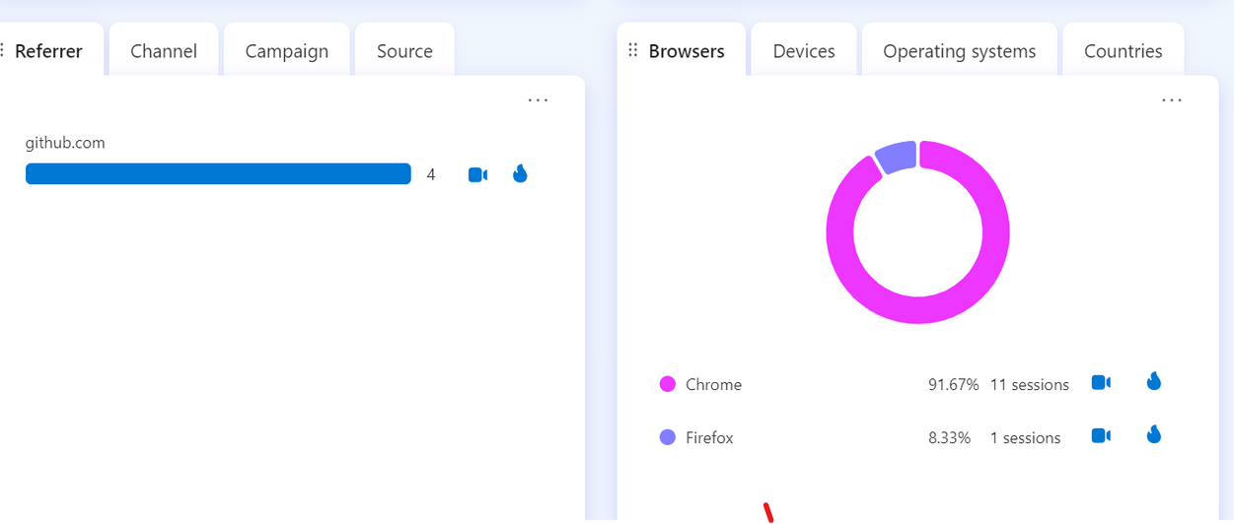
Website used :
https://priyanshu-792.github.io/Portfolio-of-Priyanshu/
Microsoft clarity Session Recording link:
Click Here to see the recording
This video link can be used effectiently for data collection

